Slide 1

University College of Engineering, Tindivanam
(A Constituent College of Anna University, Chennai)
Department of Information Technology
TITLE
Design and Evaluation of a Static Analyzer Based Design Pattern Analyzer for High-Level Languages
(Python Case Study)
BATCH NO: 3
SUPERVISOR: Dr. R. Shyamala, M.E.,Ph.D.,AP/IT
Team Members:
422422205007 NARESH M
422422205027 HARIHARAN S R
422422205032 RAKSHAYA S

Slide 2
S.No | Paper (Author,Title, Journal Name,Year) | Key Idea / Approach | Advantages | Disadvantages | Evaluation Metrics | Data Set (if required)
1 | Yama:Precise Opcode-Based Data Flow Analysis for Detecting PHP Applications Vulnerabilities (2025) | Performs context-sensitive interprocedural taint analysis on Zend Opcodes rather than source code. Uses a two-step approach: 1) CFG construction from jump instructions; 2) Forward data flow with type inference. | High precision due to clear control flow in opcodes Effective at identifying zero day vulnerabilities (38 found). | Lacks sophisticated constraint-solving coarse granularity intaint sanitization. | 1.True Positive Rate (99.1%) 2.Number of CVE IDs assigned (34). | 24 popular GitHub projects with >1,000 stars (Real-world PHP apps).
2 | ForBac: A Static Analysis Approach With Forward and Backward Analysis for Precision in Floating-Point Computations(2025) | Combines forward analysis (tracking error propagation) with backward analysis (calculating minimal input precision required) using Abstract Interpretation on Interval domains. | Dual input: Source+ bytecode features 95.78%: Average accuracy 8 types: Common vulnerabilities | Enhances precision in safety-critical Systems. Provides a scalable solution for numerical inaccuracies. | 1.Computational overhead from iterative forward-Backward passes. | Standard numerical benchmarks: Newton Raphson, Jacobi Iteration, and PolyBench/C.

Slide 3
3 | The Best of Abstract Interpretations (POPL 2025) | Proposes a formal logic to define and prove "Best Correct Approximations" (bca). Focuses on the absolute upper bound of precision for any given abstract domain. | Provides an absolute upper bound for Precision Minimizes false alarms. | Theoretical complexity The property of being "the best" is not naturally compositional | 1.Proof of validity for abstract triples 2.Precision gain over non-bca methods.
4 | CoSSJIT: Combining Static Analysis and Speculation in JIT Compilers (2025) | Integrates expensive static points-to analysis into a JIT compiler. It "speculates" that static results remain valid at runtime, falling back only if checks fail. | Achieves 5.7x improvement in stack allocation Bridges the gap between static precision and run-time specialization. | .Requires modifications to production JIT compilers Potential for speculation failure. | 1.Performance speedup 2.Stack allocation efficiency 3.Functional correctness. | Production Java Virtual Machine and large-scale Java programs.
5 | PHU+0050Joy: A Novel Extended Graph Based PHP Code Analysis Framework (2025) | Maps PHP code to an Extended Semantic Graph that merges AST, CFG, and PDG. Uses a specialized graph query framework with a high performance cache. | Reduces runtime analysis overhead by 76.54% Improves semantic edge discovery by 23.76%. | 1.Large memory footprint for storing massive semantic graphs (269M+ edges). | 1.Runtime overhead reduction 2. Semantic edge discovery rate. | 333 popular open-source PHP programs.

Slide 4
Problems We Analyzed:
The Soundness Gap (The "Missing Bug" Problem): Most current Python analyzers prioritize speed over absolute accuracy. This leads to False Negatives, where the tool says code is safe even if it contains a hidden security vulnerability.
Syntactic Noise & Dynamic Complexity: Analyzing Python at the source-code level is difficult because of its dynamic nature (like variables changing types at runtime). This "noise" often results in imprecise reports or an explosion of False Positives that overwhelm developers.
The Undecidability Challenge: Recent research confirms it is mathematically impossible for an algorithm to be 100% accurate in all cases. This creates a need for a "Best Correct Approximation"—the most precise version of a sound analysis possible for a specific language.
Performance vs. Precision Trade-off: High-precision mathematical models (like Abstract Interpretation) are often too slow for large-scale applications. There is a critical need for an analyzer that can be both Sound (safe) and Scalable (fast).

Slide 5
Problem Statement & Objectives:
Problem Statement
Python’s dynamic features such as late binding, dynamic typing, and complex control flow make it difficult to analyze all possible runtime behaviors before execution. Existing Python analysis tools often rely on limited or heuristic checks, which may miss errors occurring on specific execution paths. A sound and principled static analysis approach is therefore needed to reason safely about Python programs without executing them.
Objectives
1. To design a sound static analysis framework for Python based on abstract interpretation.
2. To represent program behavior using abstract states that capture possible variable values and control-flow conditions.
3. To analyze loops and control-flow constructs using fixpoint computation to ensure safe and finite analysis.
4. To improve analysis precision through flow-sensitive and path-sensitive data-flow analysis while preserving soundness.
5. To implement and demonstrate a prototype static analyzer capable of detecting potential runtime errors in Python programs.

Slide 6
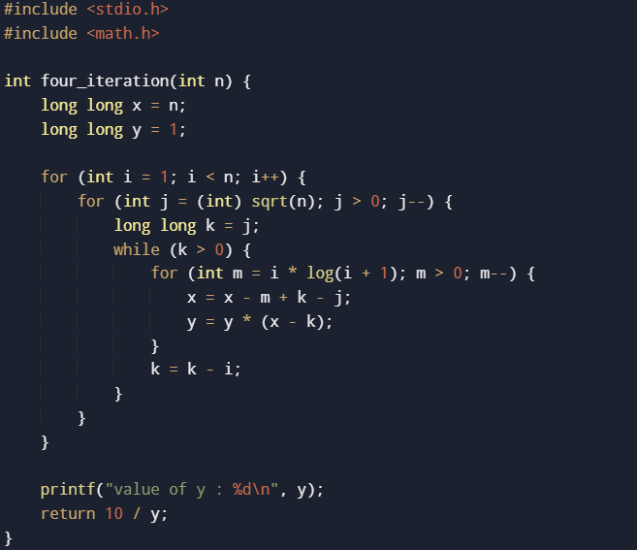
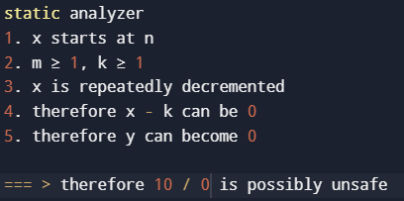
Example-1

Slide 7
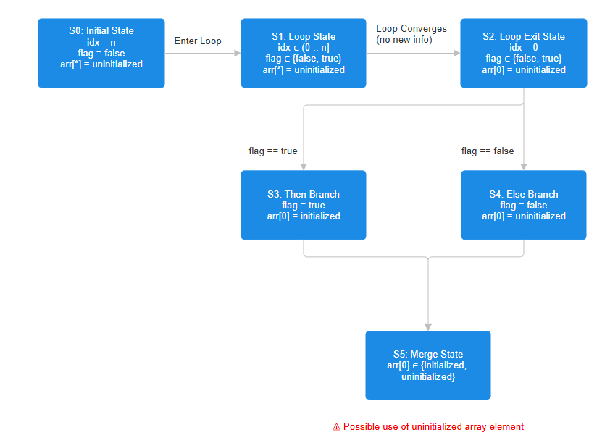
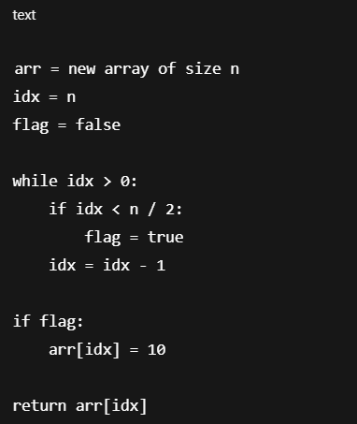
Example 2

Slide 8
The Approach: Develop a Bytecode-based Static Analysis Framework using Abstract Interpretation. By shifting from raw source code to Python Opcodes, the analyzer bypasses syntactic ambiguity. Key Features: Mathematical Soundness: Uses "Best Correct Approximation" (BCA) to ensure no execution path is ignored, eliminating false negatives. Opcode-Level Taint Tracking: Tracks data flow from "Sources" (user input) to "Sinks" (critical functions) at the virtual machine level. Context-Sensitive Analysis: Distinguishes between different calls to the same function to reduce false positives. Goal: To provide a formal security guarantee for Python applications, ensuring they are free from "silent" runtime errors and vulnerabilities like SQL Injection and XSS.
Proposed Solution

Slide 9
1.Hardware Requirements: Processor: Intel i5/i7 or AMD Ryzen 5 (Equivalent or higher) for graph processing. RAM: Minimum 8 GB (16 GB recommended for analyzing large-scale multi-module projects). Storage: 256 GB SSD (For fast read/write of large semantic graphs).
Hardware & Software Requirements
2.Software Requirements:
Programming Language: Python 3.10+ (Utilizing the dis module for disassembling and inspect for runtime metadata). Libraries & Frameworks: 1.NetworkX: For constructing and traversing the Control Flow Graph (CFG). 2.Z3 Prover (Optional/Advanced): For constraint solving to prune unreachable paths. 3.Pytest: For automated testing and validation of the analyzer. Operating System: Linux (Ubuntu/Debian) or macOS (Recommended for stable toolchain management). IDE: VS Code or PyCharm with Debugging support.

Slide 10
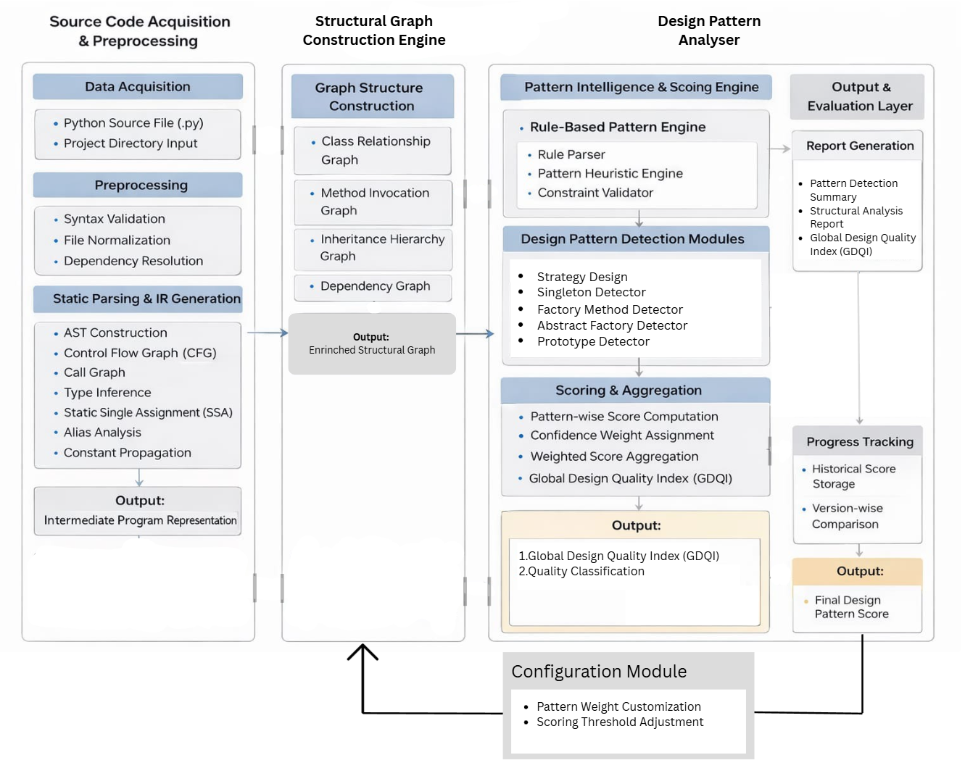
System Architecture

Slide 11
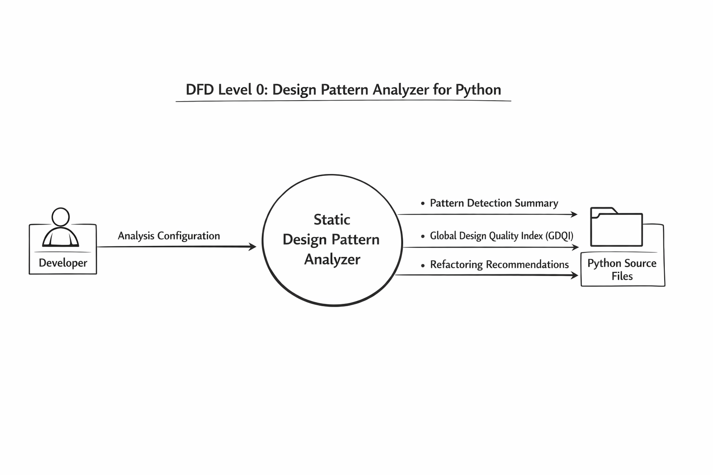

Slide 12
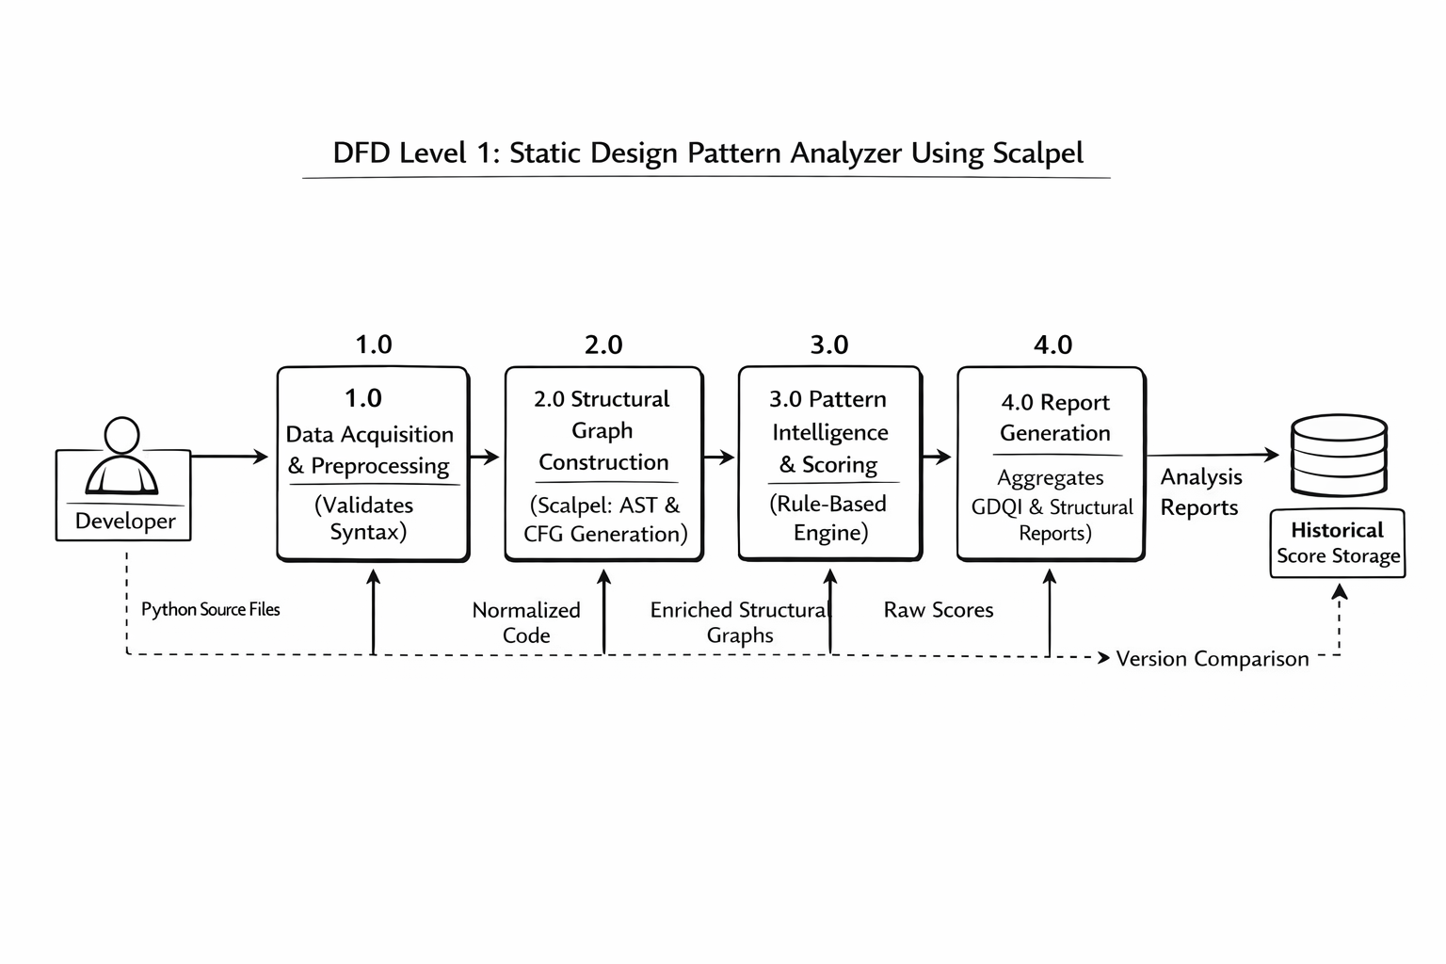

Slide 13
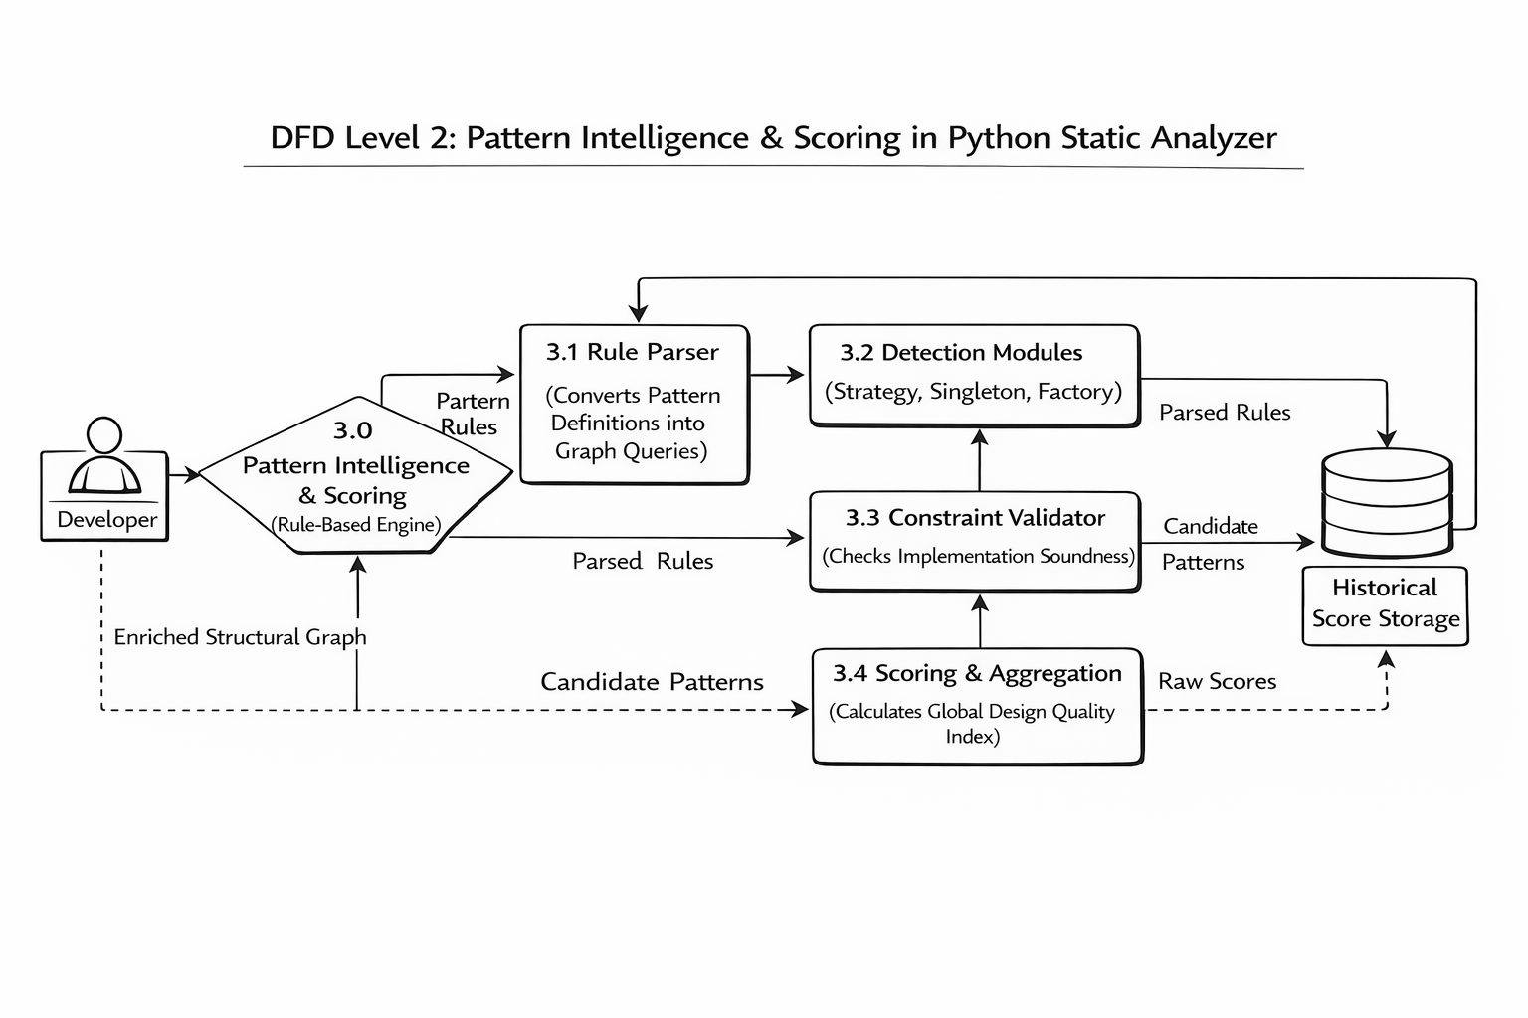
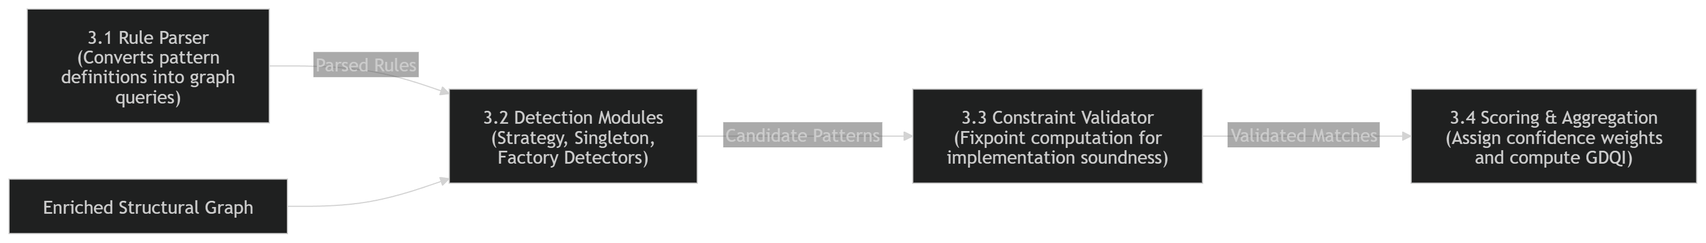

Slide 14
Use case Diagram

Slide 15
References:
1.Yama: Precise Opcode-Based Data Flow Analysis for Detecting PHP Applications Vulnerabilities
https://ieeexplore.ieee.org/document/11095739/
2.ForBac: A Static Analysis Approach With Forward and Backward Analysis for Precision in Floating-Point Computations
https://ieeexplore.ieee.org/document/10990216
3.The Best of Abstract Interpretations
https://dl.acm.org/doi/epdf/10.1145/3704882
4.CoSSJIT: Combining Static Analysis and Speculation in JITCompilers
https://dl.acm.org/doi/epdf/10.1145/3763149
5.PHPJoy: A Novel Extended Graph-Based PHP Code Analysis Framework.
https://ieeexplore.ieee.org/document/11181216

